Slide 1


GameCo Market Analysis
By: Puneet Badwal

Slide 2
Presentation Overview “Where GameCo stand now, and where it should go in 2017”
First, we will analyze the current landscape of game sales, specifically based on the percentage of global sales by region (North America, Europe, and Japan)
Based on the geographical trends of sales, we will look at data specifically from 2005-2016, to conduct analysis
We will then look at the top performing genres by region, followed by the publishers that produce the most titles for the top 3 selling genres
Lastly, we will look at the platforms that produced the most sales on a per title basis across all regions
Finally, we will look at our revised understanding of the market and recommendations on how GameCo should proceed in 2017, based on all the findings above
*All data comes from “vgsales_clean.xlsx” data source*
*All ‘Units Sold’ will be displayed in Millions, and ‘Titles Produced’ are accurate figures *

Slide 3

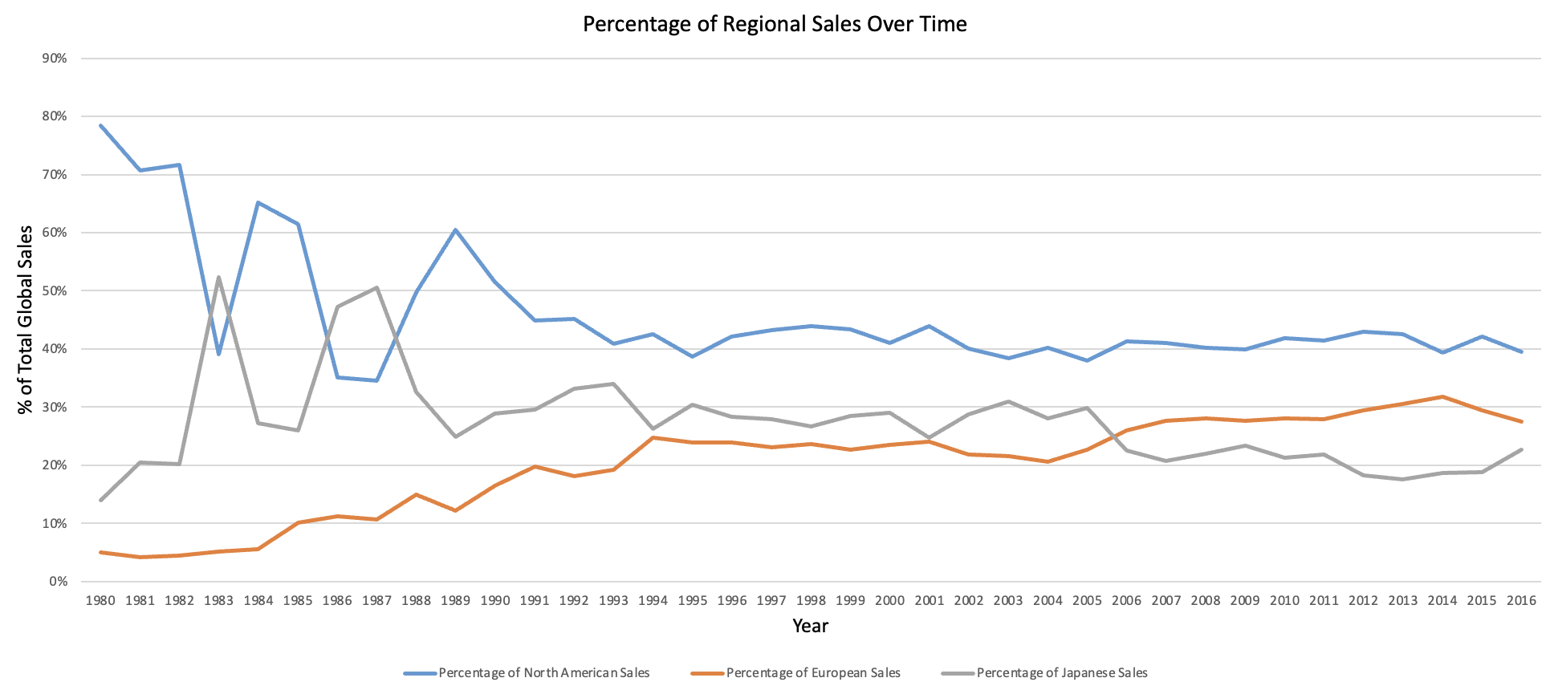



Regional Market Shares
North America has held a large percentage of total global sales, consistently hovering around 40% share
The European market has recently surpassed the Japanese market (highlighted 2005), and has since remained in 2nd place
Although the Japanese market was competing with NA in the early days of gaming (1981-1987), it has drastically decreased in recent years
Based on the current climate, we will be looking into data from 2005-2016 in all our findings for relevant game sales data

Slide 4
Top Selling Genres by Region
Despite there being over a dozen genres, the top 5 genres from 2005 to 2016 were always Action, Sports, Misc, Shooter, and Role-Playing genres
All 3 regions had the exact same top 3 best selling genres:
1. Action
2. Sports
3. Misc
North America and Europe have the exact same market for genres, while the only difference for Japan is switching Role-playing and shooter in the 4th and 5th spots
Next we’ll take a look at the publishers that produced the most titles in the Action, Sports and Misc genres…

Slide 5
Top Selling Publishers by Genre
For both the Action and Miscellaneous genres, the top 3 publishers/competitors are Activision, Ubisoft, and Namco Bandai Games
The Sports genre is dominated by the Publisher Electronic Arts, which produced more than double the number of sports titles than the second- place publisher, Konami Digital Entertainment
Of the top 3 best selling genres (Action, Sports, and Misc), Activision seems to be the largest publisher/competitor showing up in top 5 of all 3 genres
Next we’ll take a look at the platforms that produced the most sales, as well as the platforms that produced the most sales per title produced in each region…

Slide 6
Top Selling Platforms by Region
The Xbox/Microsoft market is dominant in North America based on platform performance per title with Xbox 360 and Xbox One both finishing in the top 3
In recent years, Europe has had an affinity for Playstation/Sony products on a per title basis. Both the PS4 and PS3 were top 2, respectively in Europe
While Japan has had the least amount of sales by platform, the market is completely dominated by Nintendo related products (3DS, Wii, DS, GBA) all with the producing the most sales per title.
The Wii was notably the best producing platform across the globe, producing in the top 5 of all regions
*Units Sold per Title = Total regional sales/ count of platform (titles produced)

Slide 7
A Revised Understanding….
Current Understanding – The GameCo executive board believes that sales for the various geographic regions have stayed the same over time
Evidence Shows:
Market shares for each region have changed since 2005, with North America leading the charge followed by a surging European market and declining Japanese market
Consistency has existed across every regional segment in the genres market (Action, Sports, and Misc all finishing top 3)
We can pinpoint which publishers produced the most titles in each genre, which will be the frontrunning competitor to GameCo in 2017
Each region has a “platform preference” when it comes to platform sales and platform sales per title.
Revised Understanding – We now see that various geographic regions have NOT stayed the same over time, and that each region should have a tailored marketing strategy on how to allocate budget, based on the many factors discussed above. Recommendations are as follows…

Slide 8
Recommendations for GameCo
North American Market
This will be GameCo’s largest market, and at least 40% of total global budget should be allocated based on current and historical market share
When producing games, the top genres GameCo should hone in on are Action, Sports, and Misc.
European Market
Based on the upward trajectory of the European market, and overtaking Japan for second place in 2005, GameCo should treat Europe as a “surging” gaming market, and allocate 30-40% of their global budget. This should be treated almost the same as the North American market in terms of growth potential for the future.
The top genres remain the same - Action, Sports, and Misc games should all be the primary focus.
Japanese Market
The Japanese market should be treated in a very different manner than that of the European and North American markets. Budget and marketing efforts should be focused on “revitalizing” gaming in Japan because of declining market share. Only about 20-30% of budget allocation is necessary to “jump start” this market.
The top competitor publishers will be Activision, Ubisoft, and Namco Bandai Games overall, and Electronic Arts for any sports produced games.
For partnership recommendations, GameCo should think about producing games in alignment with Xbox/Microsoft related products and system releases
Activision, Ubisoft, Namco Bandai Games, and Electronic Arts will all still be the biggest competitors
Sony/Playstation could be a great partnership opportunity from a platform front, as European’s bought the most titles for both the PS4 and PS3 in recent years
The top genres will still be Action, Sports, and Misc, with a heavier focus on Action, and treating Sports and Misc equally.
The same publishers will be the main competitors across the board, with Activision, Ubisoft, Namco Bandai Games, and Electronic Arts for sports games.
As Japan is a smaller market, it does seem to have a niche for Nintendo gaming consoles and titles. If a partnership can be made with Nintendo, and all budget is spent in tandem with Nintendo platform/title releases, this would be a great marketing strategy to narrow its focus on what the Japanese market data suggests

